Slide 1
QI for TEE
May 2022

Slide 2
Previous QI recommendations (Sept 2021)
Adhere to VGH Standards for TEE exam (Dr. Mullane).
  Ensure all chambers and valves are reported on
Record all 28 views in pre-intervention study
  and ideally post-intervention
Valve dysfunction mild or worse requires quantification
  or a description of why quantification could not be performed
LV systolic function that is not normal requires quantification
  Ideally a measurement of LVEF performed in every study
Comment on restrictions to image quality in the summary
Comment on any issues with probe insertion

Slide 3
TEE QI audit
Durkin, Hughes, McLean, Mullane
Q6months
  Studies from half of cardiac group
  5 studies/practitioner from previous year (2021)
  2 independent re-reads
Identify themes for quality improvement
  Imaging
  Interpretation/measurement
  Documentation

Slide 4
QI Findings
TEE studies and reporting of high quality
Recognize limitations
  Learners
  Time constraints
  Mixed operators / report authors
  Expanded Echo group (Apr 2021)

Slide 5
QI Findings
Areas for improvement
  Imaging
    Review images prior to sending to Syngo (delete short clips, high interference, etc)
    Ensure 28 views obtained
    Commonly missed
      Cannulae
    Duke perioperative TEE protocol
      https://anesthesiology.duke.edu/?page_id=816767
  Interpretation/measurement
    Measurement discrepancies
    Changes to syngo template
  Documentation
    Syngo review

Slide 6
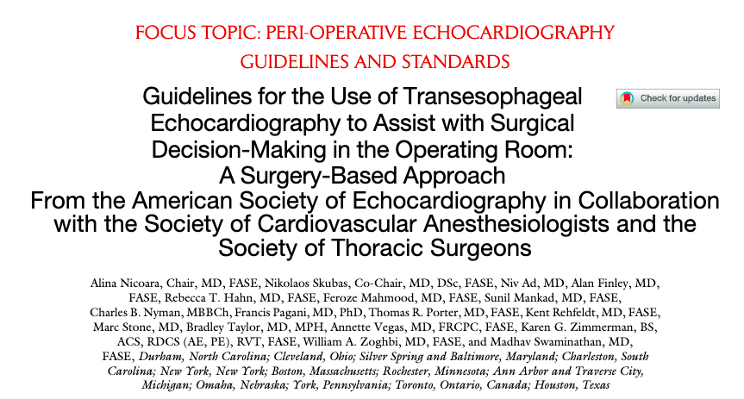
Image interpretation/measurement

Slide 7
Ventricular and valvular function
Must quantify if abnormal
  LV - Simpson’s or 3D LVEF
  RV - TAPSE or s’
  Valvular dysfunction
    At least one quantification method

Slide 8
Aortic root measurements
LVOT and AV annulus
  Mid-systole
  Inner edge to inner edge
Sinuses, STJ, ascending, arch, descending
  End-diastole
  Leading edge to leading edge
Lang et al. 2015
Notes:
Leading edge to leading edge was originally recommended by the American Society of Echocardiography (ASE) in 1978 due to the belief that this technique reduces inaccuracies in measurement that could arise from blooming artifact due to the aortic wall being a bright reﬂector.9 Large studies that were done after those ASE recommendations and multiple guidelines have since used the leading edge to leading edge in end-diastole technique, and thus most available prognostic data have stemmed from this convention.

Slide 9
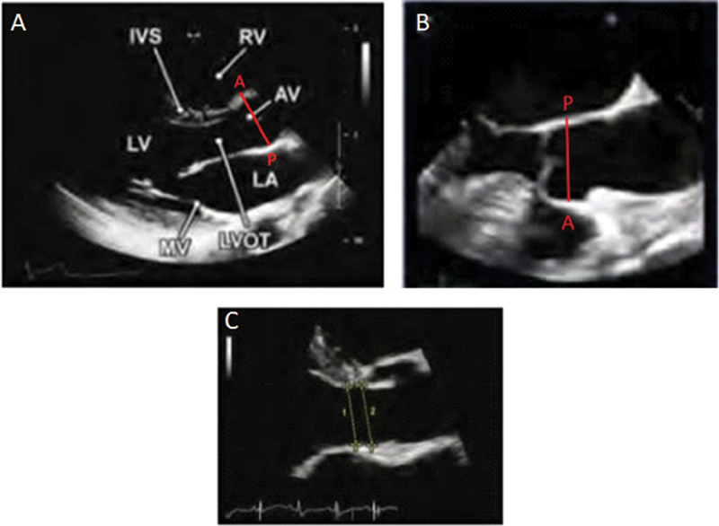
Upadhyaya et al 2021

Slide 10
RV measurements
  If function is abnormal, must quantify
    TAPSE, s’
  RV linear dimensions best assessed in RV focused 4 chamber view
    Maximize end diastolic dimension while maintaining 4 chamber view
    No mild,mod, severe in guidelines, therefore will change Syngo to “normal, enlarged, severely enlarged”
  RVH
    Normal RV thickness 3-5mm
    No mild, mod, severe in guidelines, therefore will change Syngo to “normal vs. hypertrophied”
Lang et al 2015
Notes:
For TTE, RV dimensions are best estimated from a RV-focused apical four-chamber view obtained with either lateral or medial transducer orientation (Lang et al 2015)

Slide 11
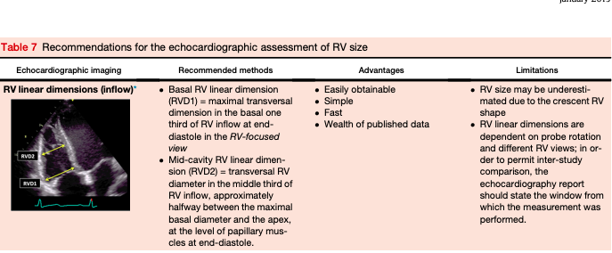

Slide 12
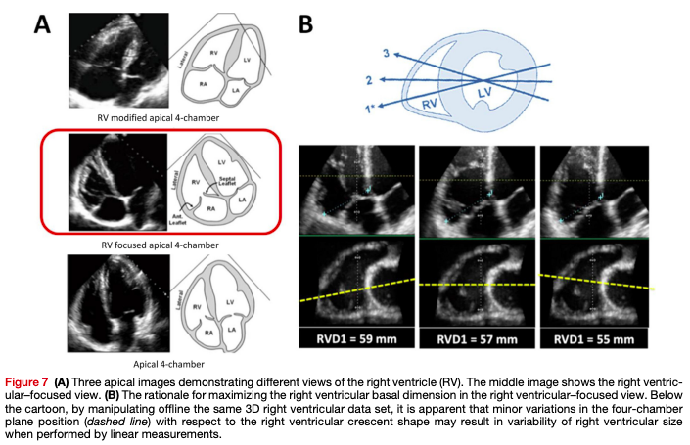

Slide 13
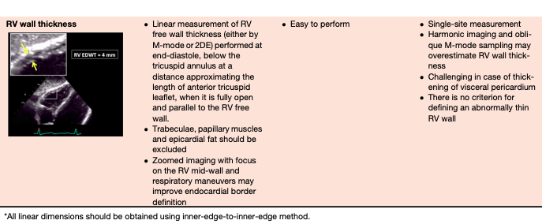

Slide 14
LA size measurement
  Best measured in mid-systole in AV short axis view from transducer to edge of LA
    Underestimates TTE LA size measurement by 9%
      Block et al, JASE, 2002
  No mild, mod, severe in guidelines therefore will change to “normal, enlarged, severely enlarged

Slide 15
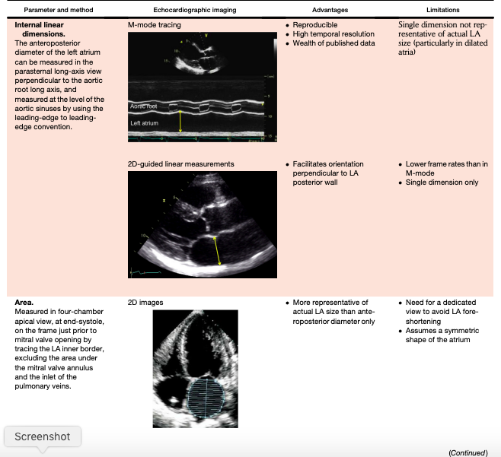

Slide 16
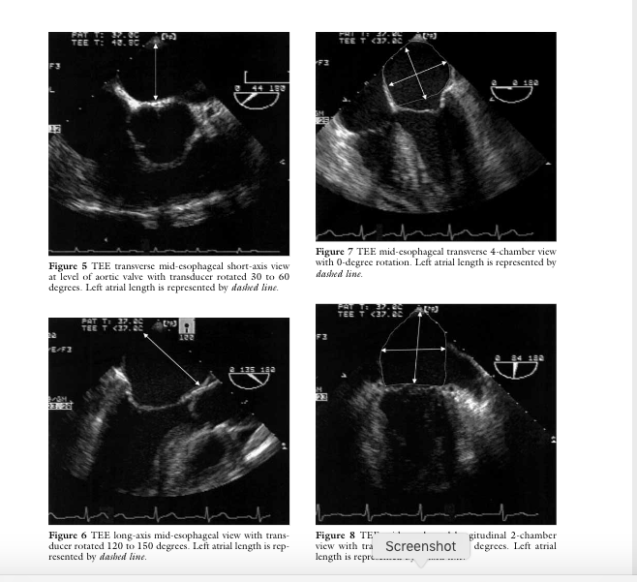
Block et al 2002

Slide 17
MV repair assessment
SAM risk
  ME 5-chamber or ME LAX
  PL/AL lengths should be taken in "mid diastole."
  The ratio of Anterior to Posterior Leaflet Height, C-sept distance, basal septal thickness, and Mitral-aortic angle are all measured at "end systole"
Notes:
The risk for systolic anterior motion (SAM) after MV repair shouldbe assessed prior to surgical intervention. A myxomatous MV withredundant leaflets, especially excessive anterior leaflet tissue, and anon-dilated hyperdynamic left ventricle, are frequent predisposingfactors.2In the ME 5Ch or ME LAX views, the lengths of the posteriorand anterior MV leaflets (in mid-diastole), the ratio of the anterior andposterior leaflet heights measured at end-systole from the mitralannulus to the coaptation point, the end-systolic distance from thecoaptation point perpendicular to the interventricular septum (IVS),also known as the ‘‘C-sept distance’’, and the angle between theMV and AV planes should be measured (Figure 2). These measure-ments can also be performed by multiplanar reconstruction of 3Ddata sets, which enables manipulation of the position of the planeof measurement and elimination of the parallax error due to obliqueorientation.13Independent predictors of SAM post MV repairinclude: a thick basal interventricular septum (>15 mm), a short C-sept distance (<25 mm), a narrow aorto-mitral angle (<120),Figure 2Echocardiographic measurements for predicting therisk of systolic anterior motion after mitral valve repair. Abbrevi-ations:AL, Anterior leaflet height measured from the aorticannulus to the coaptation point;C-sept, distance from the coap-tation point to the interventricular septum measured at end-systole perpendicular to the septum;PL, posterior leaflet heightmeasured from the aortic annulus to the coaptation point.Figure 1(A)Mitral valve seen en face in a 3D data set from the left atrial perspective (‘‘surgeon’s view’’). Flail large P2 segment can beseen (white arrow).(B)Mitral regurgitation jet seen with color flow Doppler, originating at the level of the flail P2 segment and directedanteriorly.696 Nicoara et alJournal of the American Society of EchocardiographyJune 2020

Slide 18
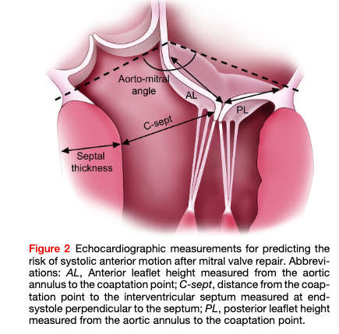
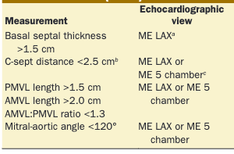
Hymel AandA 2014
Nicoara JASE 2020

Slide 19
MV repair assessment (cont.)
TV assessment
  TR grading
    Vena contracta, hepatic venous flow, (EROA by PISA)
  TV annular dimension
    40mm or 21mm/m² end-diastolic diameter

Slide 20
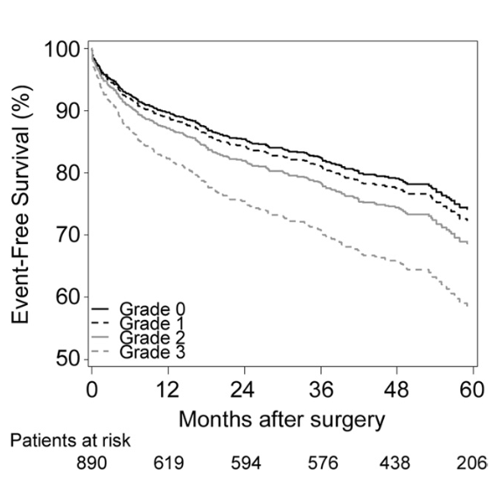
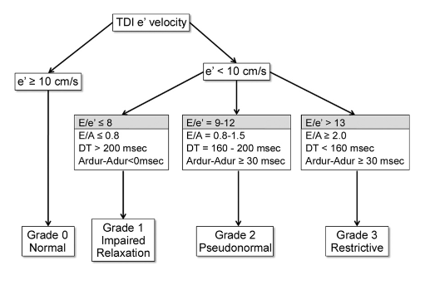
Diastology
Attempt to measure e’ and E according to algorithm
Comment on assessment in findings or summary
  Even where indeterminate
Swaminathan et al. 2011

Slide 21
PFO assessment
Drop color doppler scale to 35-40 cm/s to assess for low velocity flow
Silvestry JASE 2015

Slide 22
MV gradient
Transmitral peak and mean gradients should be assessed using continuous wave doppler (CWD)
  “The use of CWD is preferred to ensure maximal velocities are recorded. When pulsed-wave Doppler is used, the sample volume should be placed at the level or just after leaflet tips.”
    Baumgartner JASE 2009
Comment on cardiac rhythm and HR at time of measurement

Slide 23
Documentation
Report rhythm
Comment on image quality and quantity
Comment on dynamic changes if present
  Regurgitant valves at different BP
  RWMAs
Syngo demo

