Slide 1
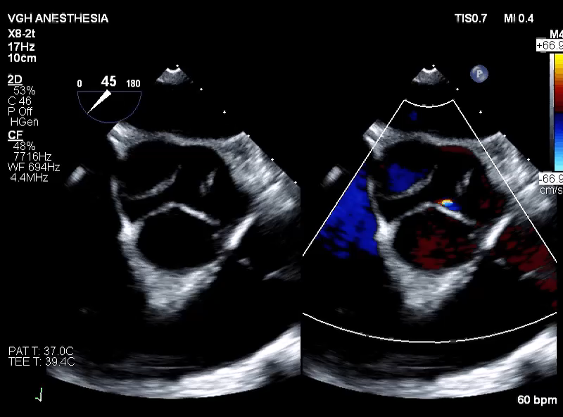
Case: 33M Ascending aortic replacement
Mild AR- no indication for repair
AV- Tricuspid
Proximal arch dilated 52mm

Slide 2
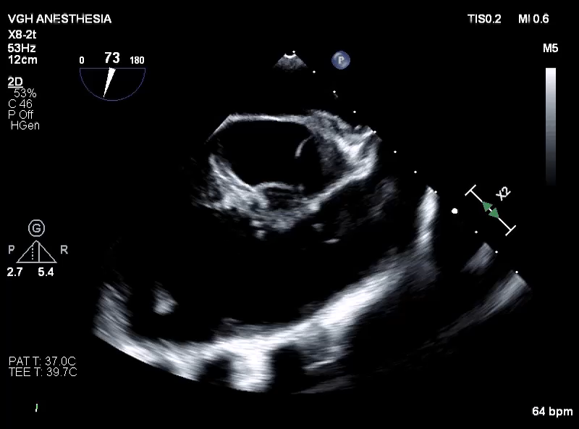

Slide 3


UPDATE: BICUSPID AORTIC VALVE (BAV) NOMENCLATURE AND REGURGITANT REPAIR
Dr. Julena Foglia
Cardiac Anesthesiology Fellow
November 29, 2022

Slide 4

Objectives
1.Review newest international guidelines for Bicuspid Aortic Valve Nomenclature
2.Review Bicuspid Aortic Valve Regurgitation
3.Review BAV repair

Slide 5
Sievers & Schmidtke
Single-center retrospective analysis of BAVs operated on from 1999 to 2003.
304 Bicuspid Aortic Valve assessed retrospectively from surgical pathology data
Commissures: is the space between the two coronet-shaped attachments of two adjacent cusps to the aortic wall normally not adhering to each other.
Raphe: defines the conjoint or “fused” area of the two underdeveloped cusps turning into a malformed commissure be- tween both cusps
Sievers HH, Schmidtke C. A classification system for the bicuspid aortic valve from 304 surgical specimens. J Thorac Cardiovasc Surg. 2007;133:1226–1233. doi: 10.1016/j.jtcvs.2007.01.039.
Notes:
In BAV- thian obliteration of the commissural area is present
Dr. Hans Sievers
Cardiothoracic surgeon
Lübeck
Dr. Claudia Schmidtke- Cardio thoracic surgeon in Germany
Professor of Cardiac Surgery in Germany

Slide 6
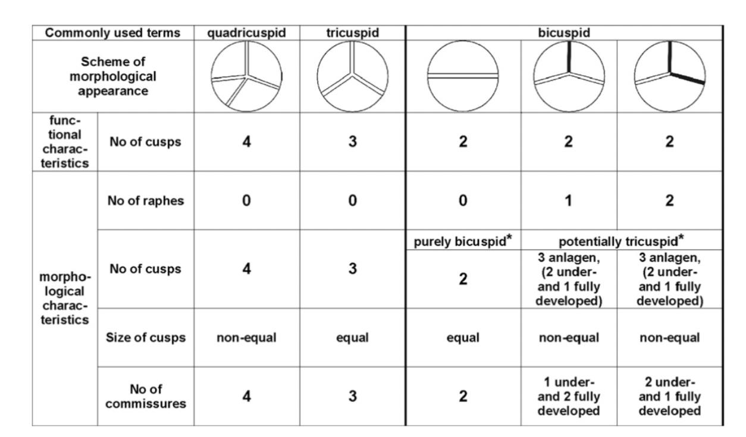
Lacks recognition of partial fusions ( Forme fruste)
Lacks recognition of Fused BAV with no raphe and 3 sinus
Lacks pre repair symmetry
Categorizes Unicuspid valve as BAV type III
Notes:
Sievers 1
Sievers 2
Sievers

Slide 7
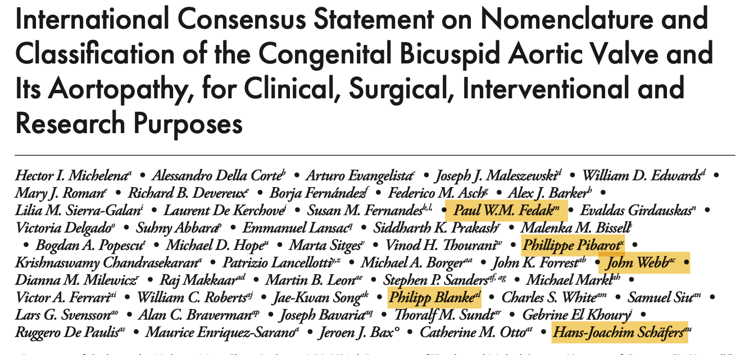
Notes:
Michelena- MAYO CLINIC

Slide 8
Why does it matter
Failure to identify phenotypes => predict outcomes
Inability to analyse clinical outcomes data in registries
Failure to capture
Goal:
Standardize nomenclature
->surgical AV repair outcomes
->TAVR expansion
->Potential Aortic repair expansion

Slide 9
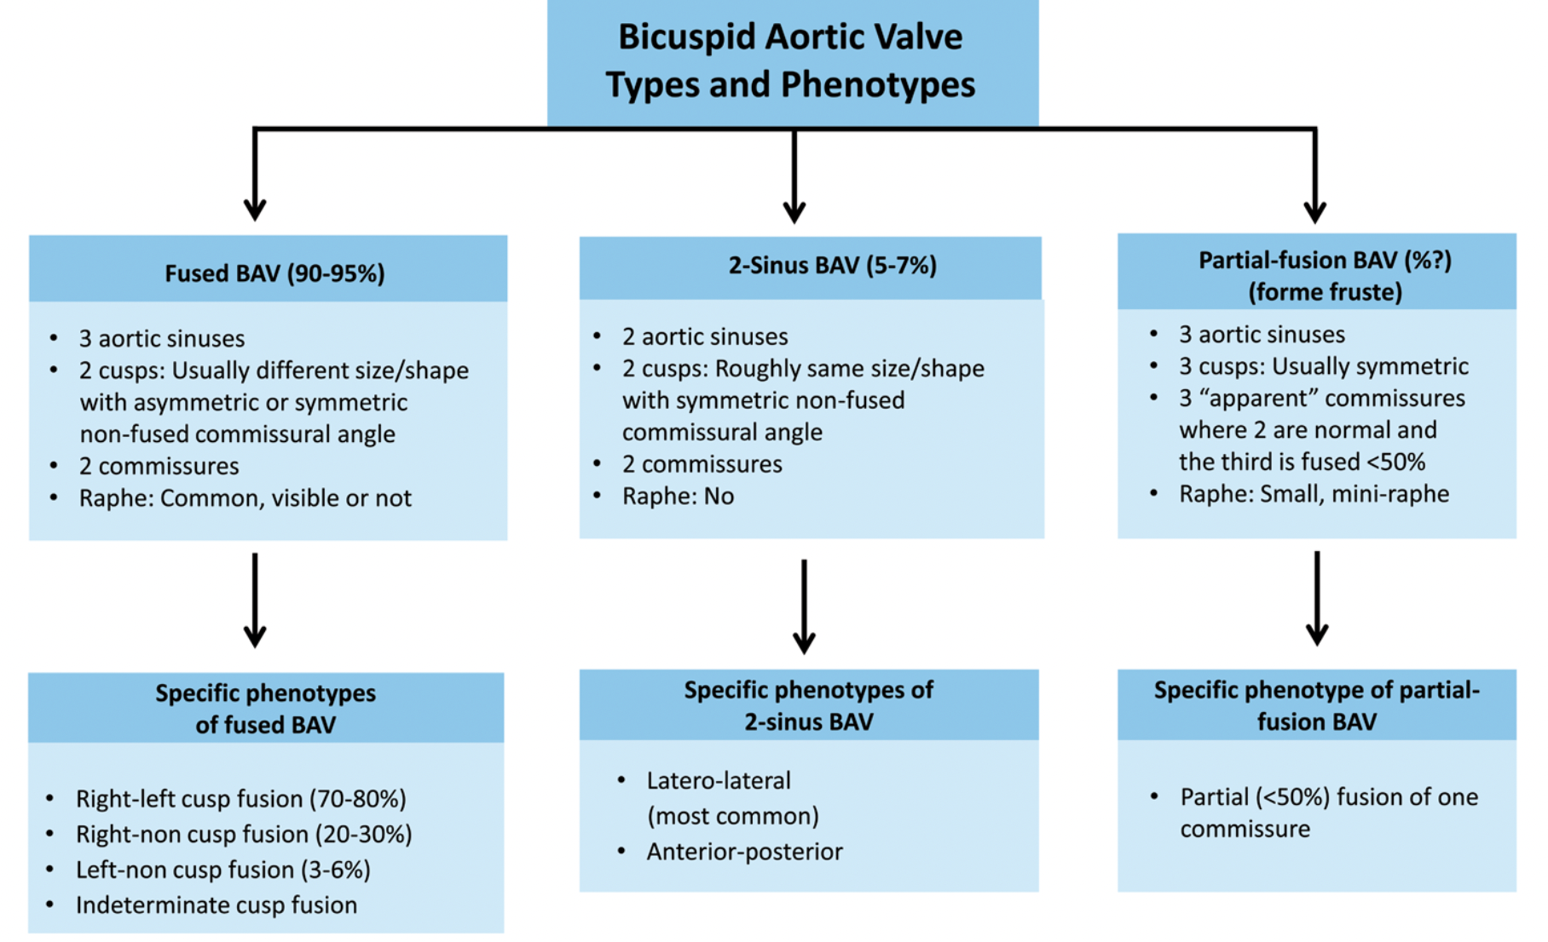
Michelena, H. I., Corte, A. della, Evangelista, A., Maleszewski, J. J., Edwards, W. D., Roman, M. J., Devereux, R. B., Fernández, B., Asch, F. M., Barker, A. J., Sierra-Galan, L. M., de Kerchove, L., Fernandes, S. M., Fedak, P. W. M., Girdauskas, E., Delgado, V., Abbara, S., Lansac, E., Prakash, S. K., … Schäfers, H. J. (2021). International consensus statement on nomenclature and classification of the congenital bicuspid aortic valve and its aortopathy, for clinical, surgical, interventional and research purposes. Radiology: Cardiothoracic Imaging, 3(4). https://doi.org/10.1148/ryct.2021200496

Slide 10
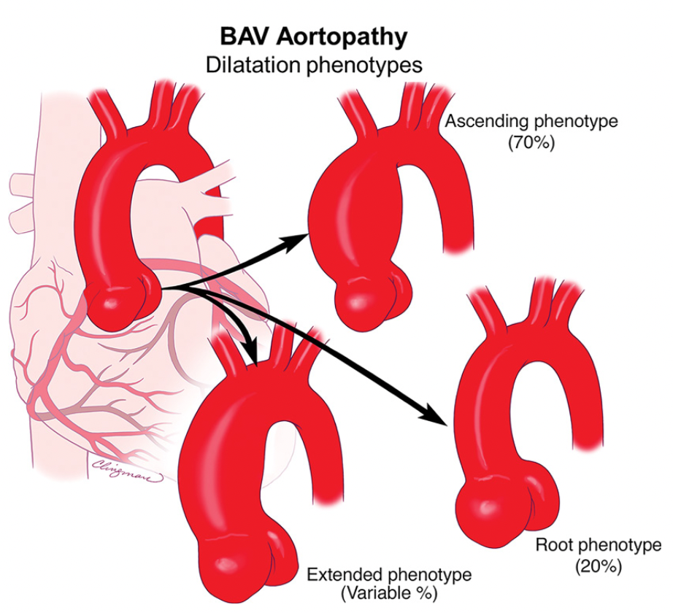
Michelena, H. I., Corte, A. della, Evangelista, A., Maleszewski, J. J., Edwards, W. D., Roman, M. J., Devereux, R. B., Fernández, B., Asch, F. M., Barker, A. J., Sierra-Galan, L. M., de Kerchove, L., Fernandes, S. M., Fedak, P. W. M., Girdauskas, E., Delgado, V., Abbara, S., Lansac, E., Prakash, S. K., … Schäfers, H. J. (2021). International consensus statement on nomenclature and classification of the congenital bicuspid aortic valve and its aortopathy, for clinical, surgical, interventional and research purposes. Radiology: Cardiothoracic Imaging, 3(4). https://doi.org/10.1148/ryct.2021200496

Slide 11
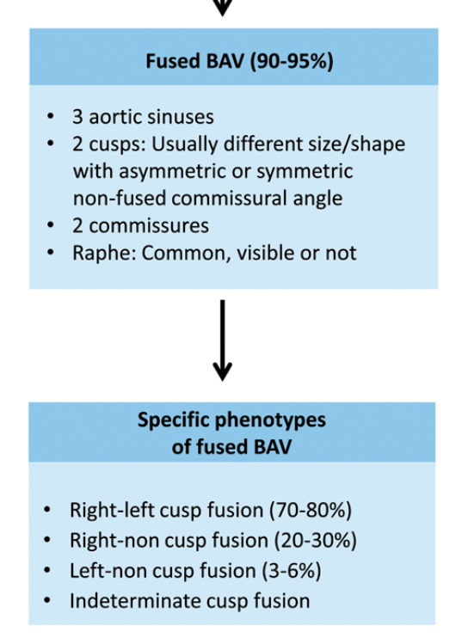
Replaces Type I
Most commonly discovered
+/-Raphe: congenital fibrous ridge between the fused cusps.
R-L most common
  Aortic root dilatation
  Aortic Regurgitation
  Coarctation
Michelena, H. I., Corte, A. della, Evangelista, A., Maleszewski, J. J., Edwards, W. D., Roman, M. J., Devereux, R. B., Fernández, B., Asch, F. M., Barker, A. J., Sierra-Galan, L. M., de Kerchove, L., Fernandes, S. M., Fedak, P. W. M., Girdauskas, E., Delgado, V., Abbara, S., Lansac, E., Prakash, S. K., … Schäfers, H. J. (2021). International consensus statement on nomenclature and classification of the congenital bicuspid aortic valve and its aortopathy, for clinical, surgical, interventional and research purposes. Radiology: Cardiothoracic Imaging, 3(4). https://doi.org/10.1148/ryct.2021200496

Slide 12
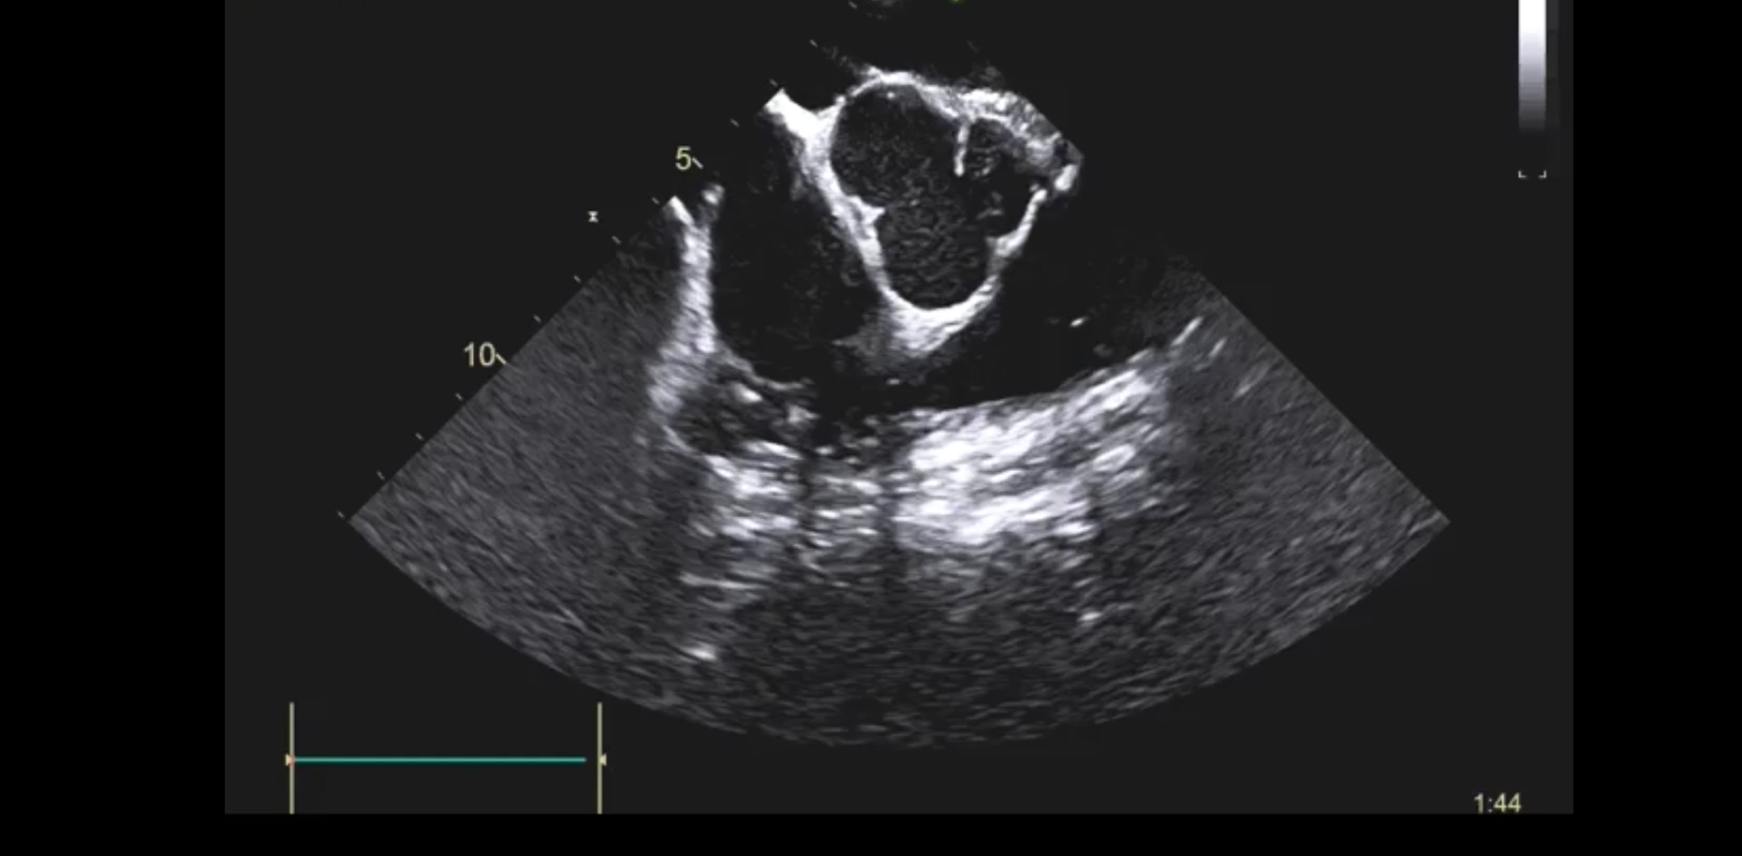
FUSED BAV

Slide 13
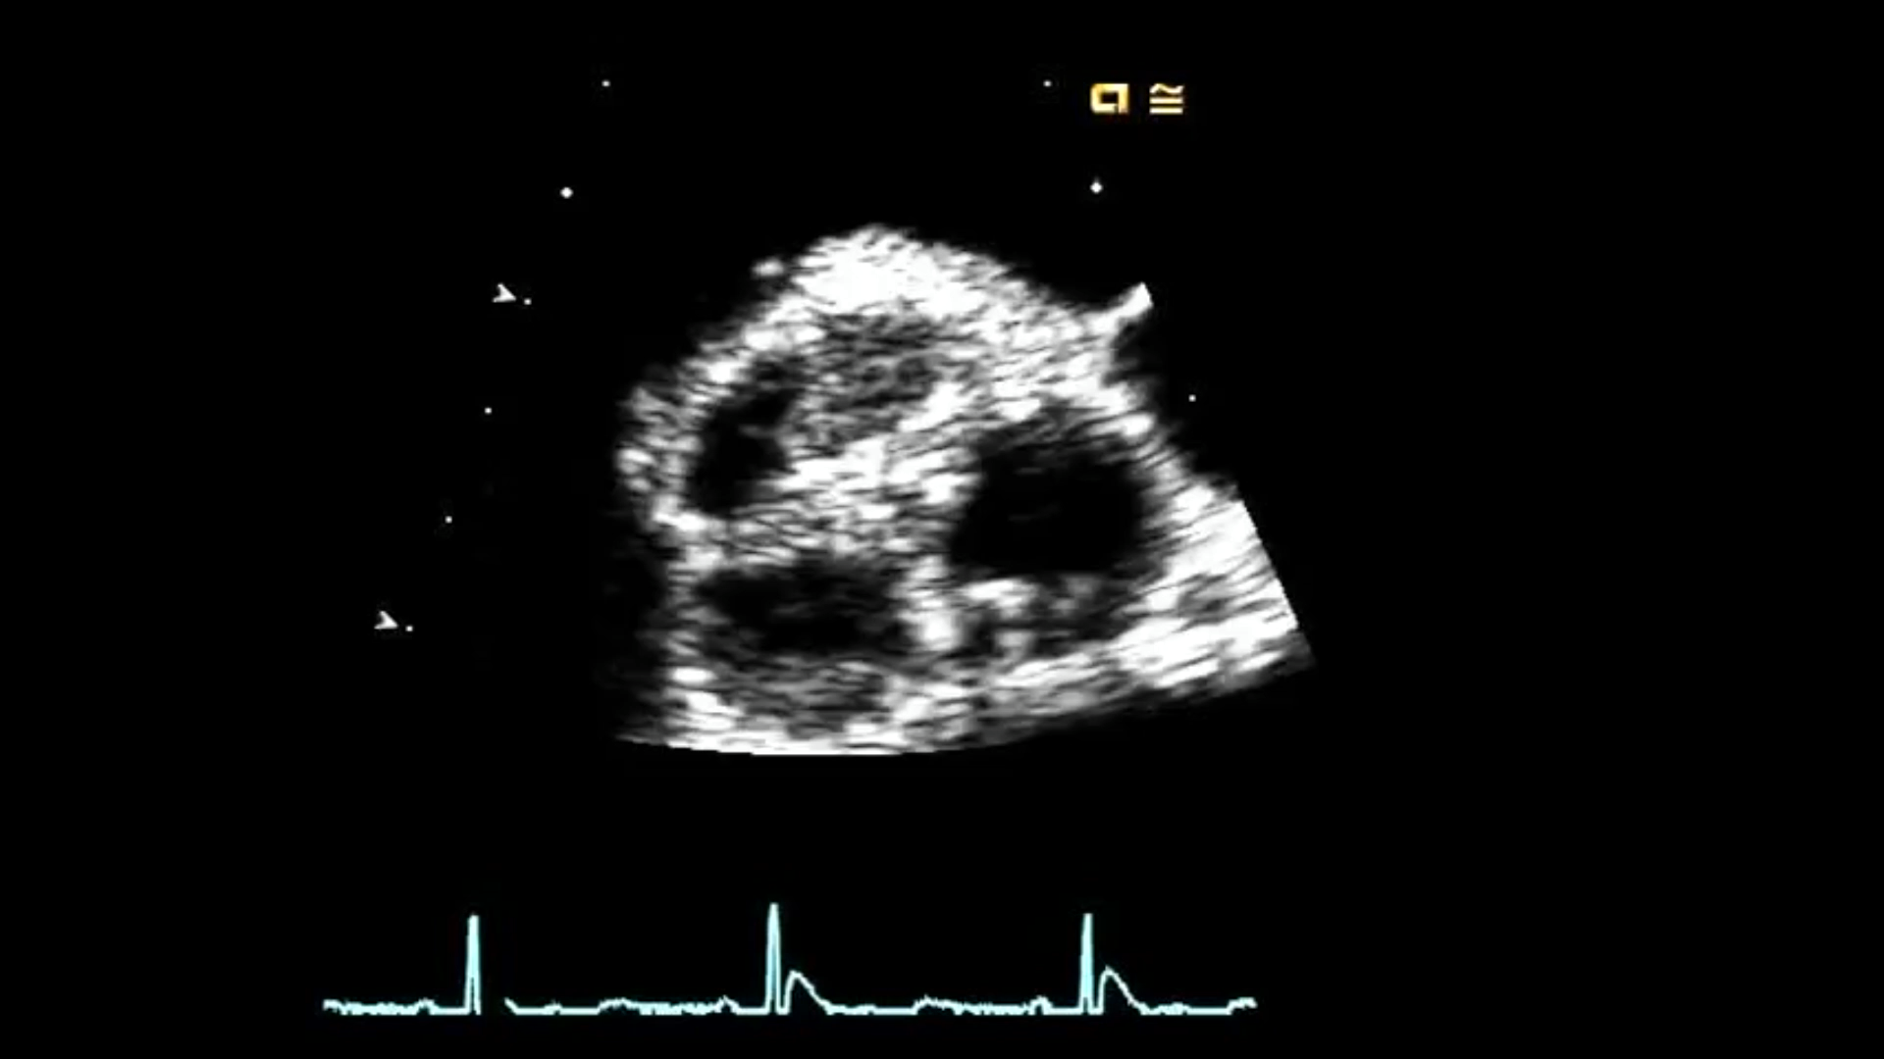

Slide 14
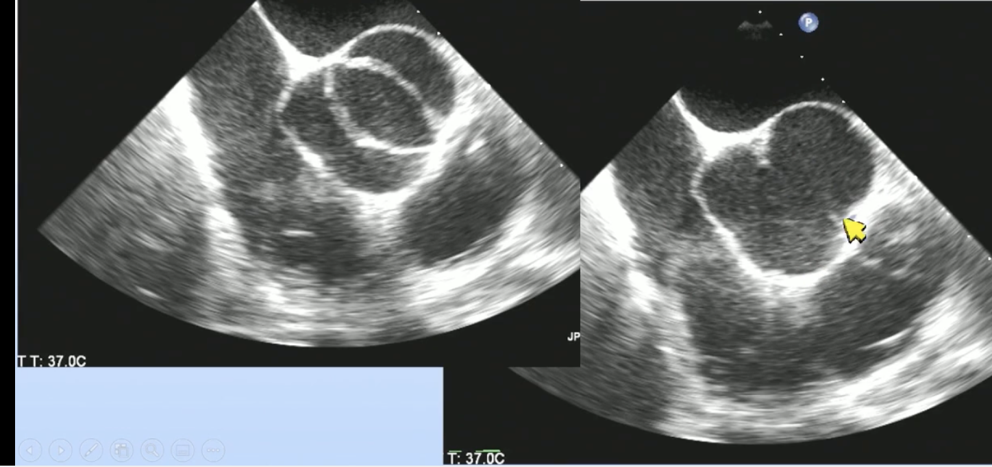
Fused
No raphe
3 Sinus

Slide 15
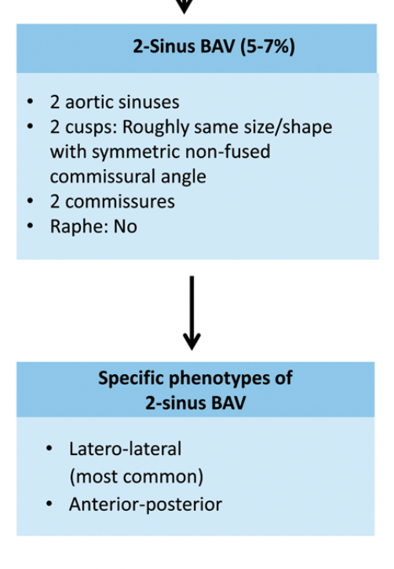
Type 0
No raphe
2 aortic sinuses
180 commissural angles
‘morphologically severe’ BAV with lack of scientific data on clinical association.
Michelena, H. I., Corte, A. della, Evangelista, A., Maleszewski, J. J., Edwards, W. D., Roman, M. J., Devereux, R. B., Fernández, B., Asch, F. M., Barker, A. J., Sierra-Galan, L. M., de Kerchove, L., Fernandes, S. M., Fedak, P. W. M., Girdauskas, E., Delgado, V., Abbara, S., Lansac, E., Prakash, S. K., … Schäfers, H. J. (2021). International consensus statement on nomenclature and classification of the congenital bicuspid aortic valve and its aortopathy, for clinical, surgical, interventional and research purposes. Radiology: Cardiothoracic Imaging, 3(4). https://doi.org/10.1148/ryct.2021200496

Slide 16
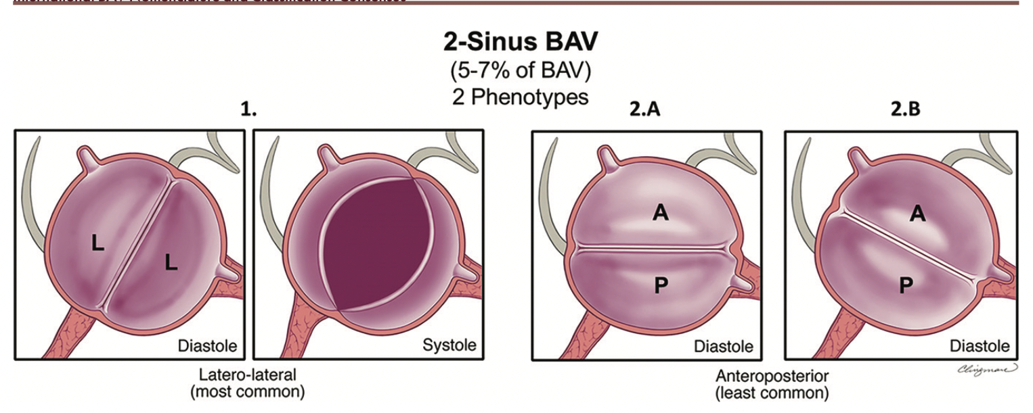

Slide 17
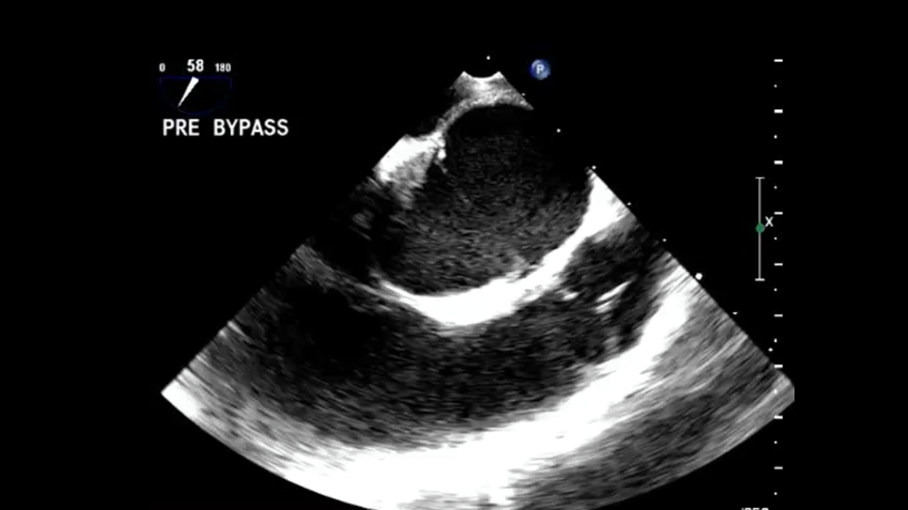

Slide 18
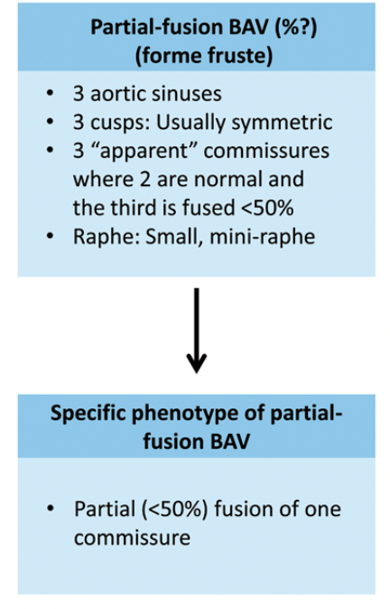
Forme Fruste
The partial-fusion type recently recognized
Prevalence is unknown
Cusp fusion <50% noted at base of a commissure, forming a small ‘mini-raphe

Slide 19
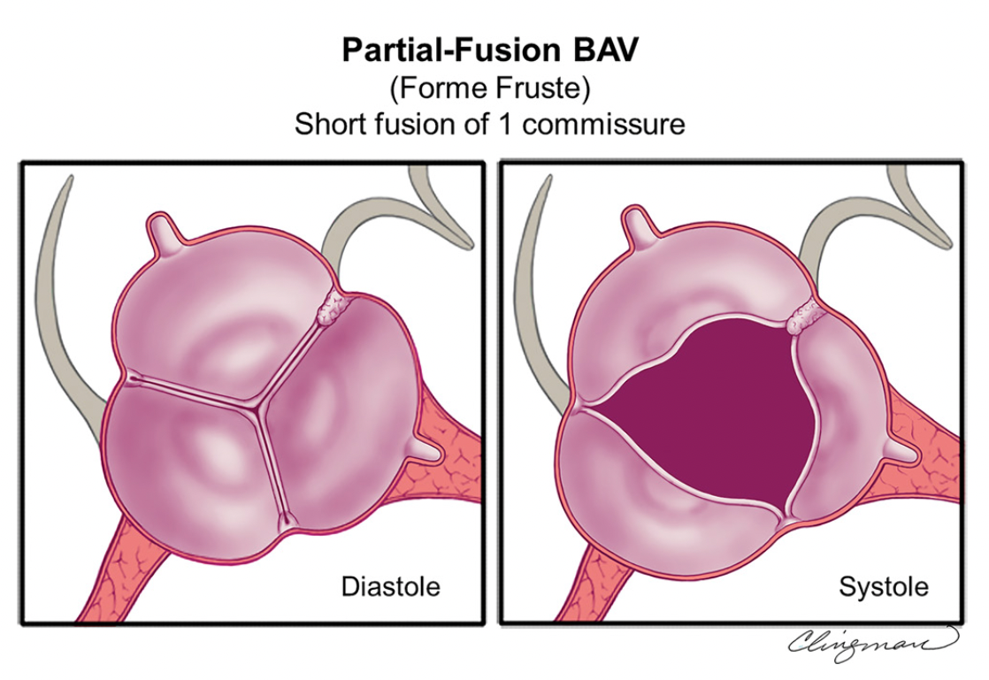

Slide 20
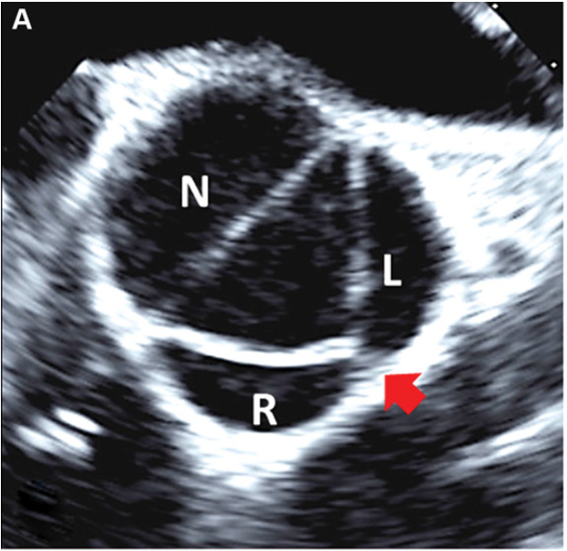

Slide 21
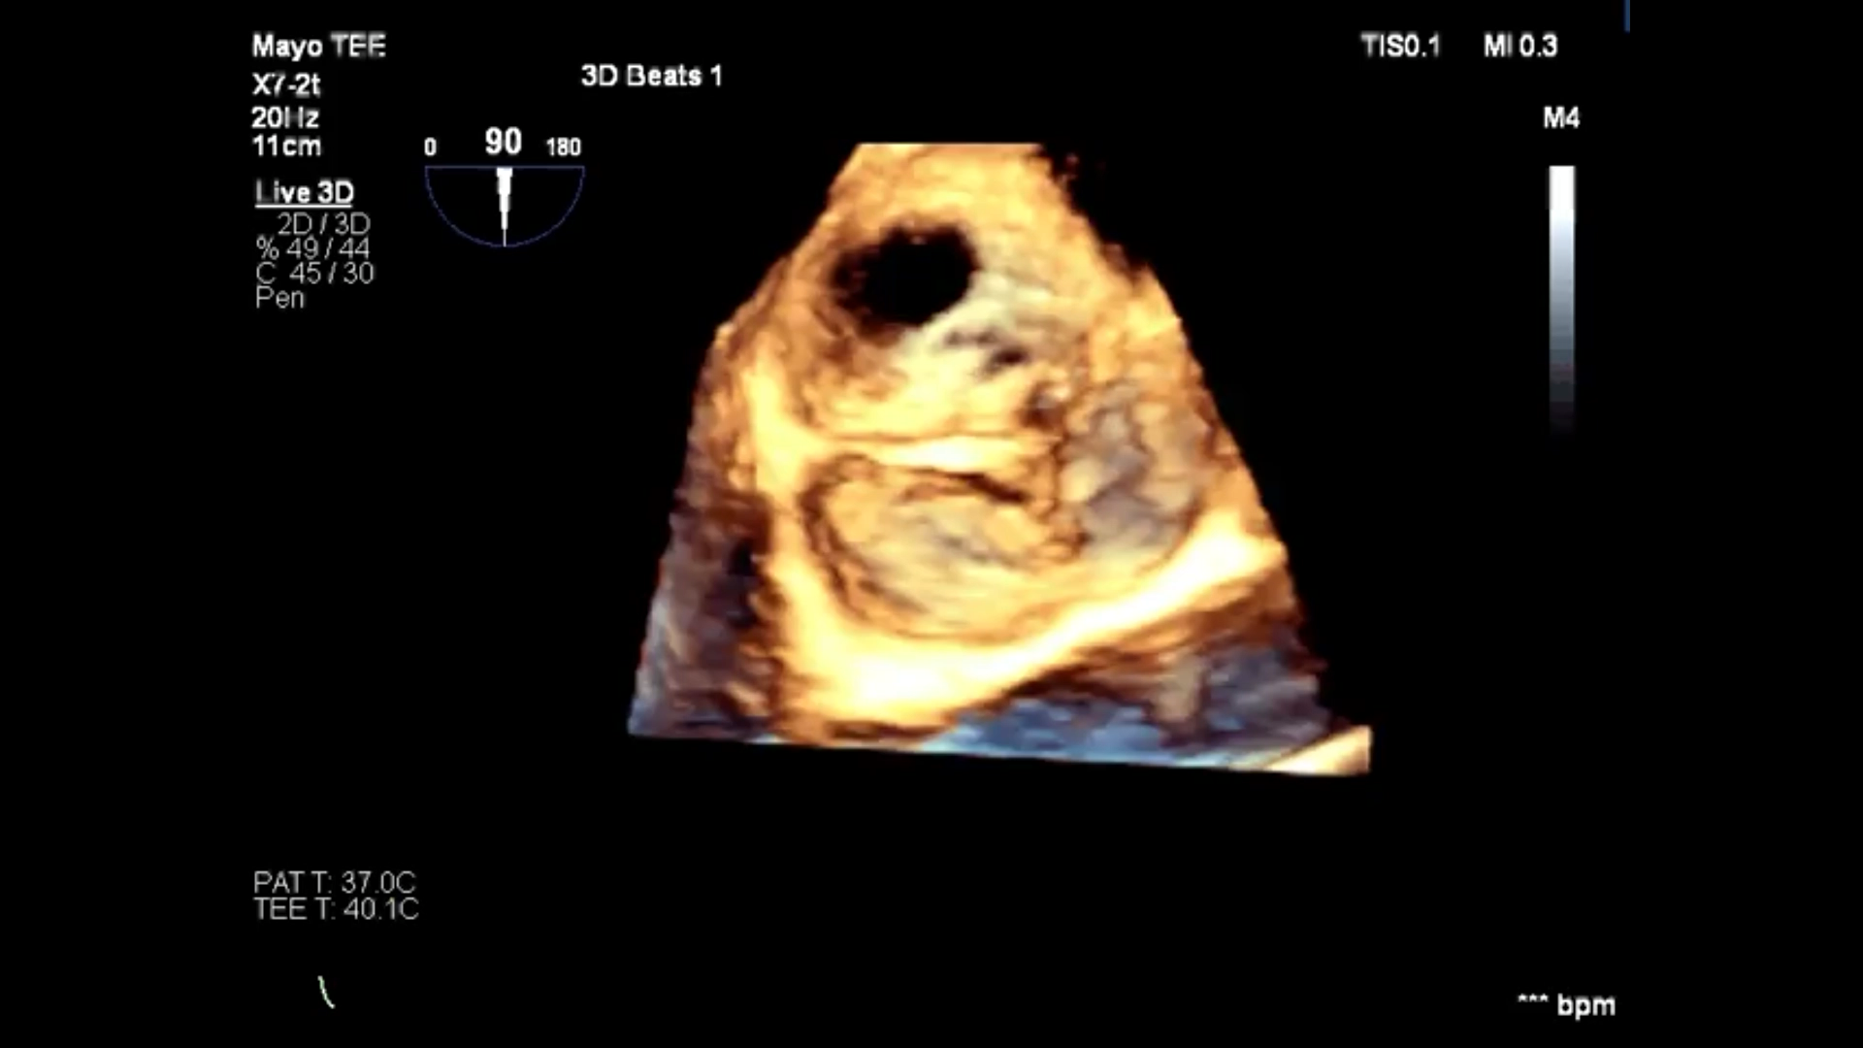

Slide 22
This Forme fruste BAV results in alteration of aortic flow patterns, consisting of increased flow eccentricity and increased vortexes perhaps partially explaining the apparent high prevalence of aorta dilatation in these patients.

Slide 23
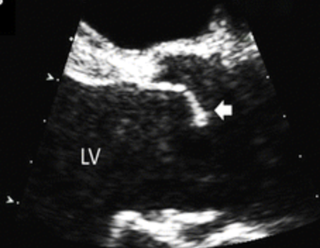
Calcified fusion vs Congenital fusion
Difficult to ascertain
ECHO: systolic doming on conjoined cusps in LAX
Surgical confirmation: define the pseudocommisure height
Pathological confirmation

Slide 24
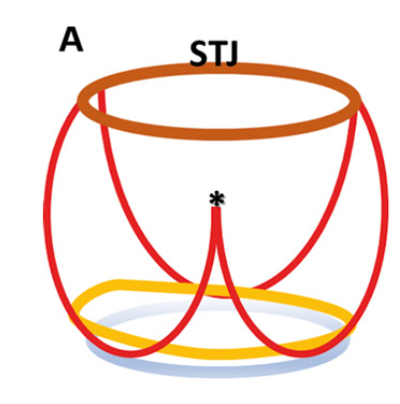
Surgically can measure the pseudocommissure
Which is the height of the under developed
Commissure under the raphe

Slide 25
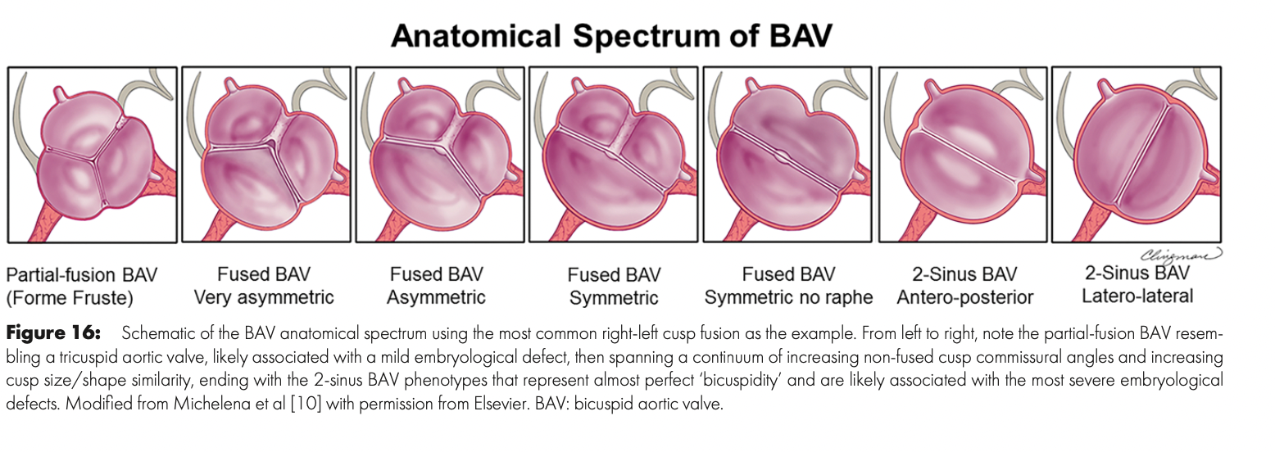
“Bicuspidity”

Slide 26
Retort from Sievers 2021
New nomenclature ”impractical”
BUT Proper communication is necessary
  Partial fusion
  Angle of commissure =Symmetry
Sievers, H. H. (2021). The bicuspid aortic valve complex: Still a mystery. In European Journal of Cardio-thoracic Surgery (Vol. 60, Issue 3, pp. 479–480). European Association for Cardio-Thoracic Surgery. https://doi.org/10.1093/ejcts/ezab073

Slide 27
Objective 2
2.Review Bicuspid Aortic Valve Regurgitation

Slide 28
Complications
Bicuspid Aortic Valve
  Aortic stenosis 70%; >age 50-60
  Aortic Regurgitation 30%; age 30’s
Aortopathy
  Thoracic dilation >45mm 40-70%
  Coarctation 7-10%
  Aortic Dissection 8x>general population
Mitral Valve Prolapse
  Isolated anterior prolapse= Giant anterior leaflet 2X
Infective Endocarditis

Slide 29
6 major aspects of ECHO
(i)BAV diagnosis
(ii) Valvular phenotyping
(iii)Assessment of valvular function
(iv)Measurement of the thoracic aorta+/- coarctation
(vi) Assess complications infective endocarditis and aortic dissection

Slide 30
Surgical treatment
Surgical Aortic Valve Replacement = Gold standard
TAVR may be option
Surgical repair option

Slide 31

Aortic Regurgitation valve repair > replacement
((in centres with extensive experience))

Slide 32
Bicuspid Aortic Valve Regurgitation
BAV regurgitation usually prolapse of the fused cusp
Other concomitant mechanisms include prolapse of the non-fused cusp and cusp retraction
Aortic annulus is often dilated (i>25 mm) +/- root complex (the sinuses ,STJ dilatation).

Slide 33
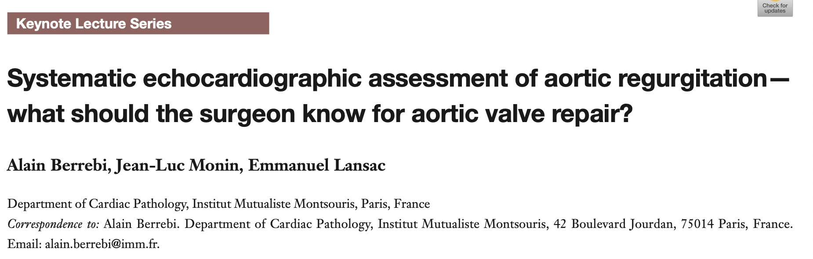

Slide 34
Pre repair features
Symmetry: angle between the commissures of the non-fused cusp.
As the angle <160° the BAV becomes less symmetrical
Less symmetrical is challenging for the surgeon to ‘bicuspidize’
Berrebi, A., Monin, J. L., & Lansac, E. (2019). Systematic echocardiographic assessment of aortic regurgitation-what should the surgeon know for aortic valve repair? Annals of Cardiothoracic Surgery, 8(3), 331–341. https://doi.org/10.21037/acs.2019.05.15

Slide 35
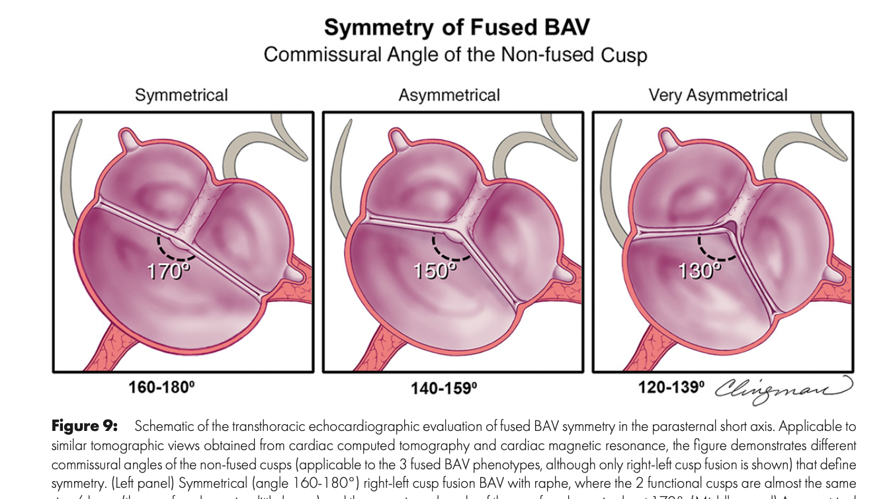

Slide 36
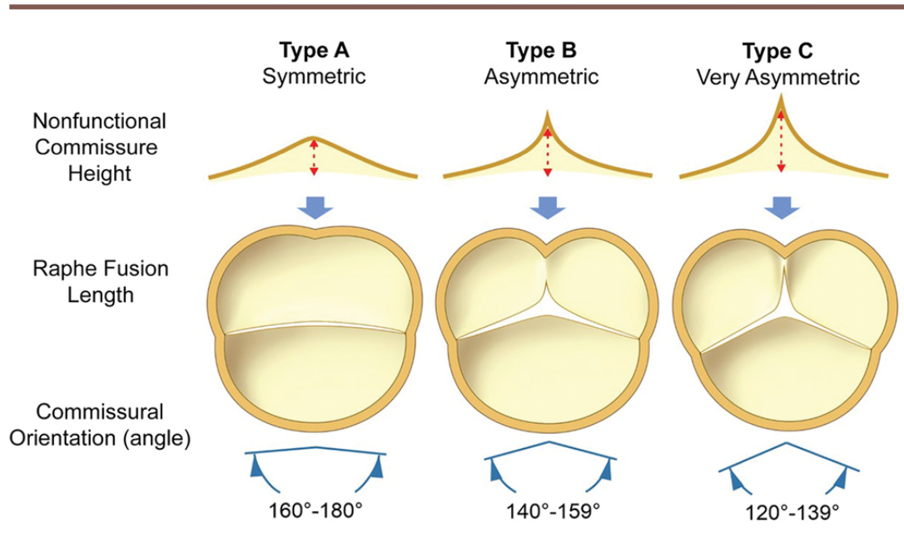
Notes:
The closer the BAV phenotype is to a 2-sinus type with a symmetrical non-fused cusp commissural angle, the more feasible the repair will
Otherwise, the surgeon uses techniques directed at ‘bicuspidizing’ the valve more (Section The bicuspid aortic valve anatomical spectrum) (Fig. 21).
If the BAV is very asymmetrical, the surgeon will treat it as a tricuspid valve instead

Slide 37
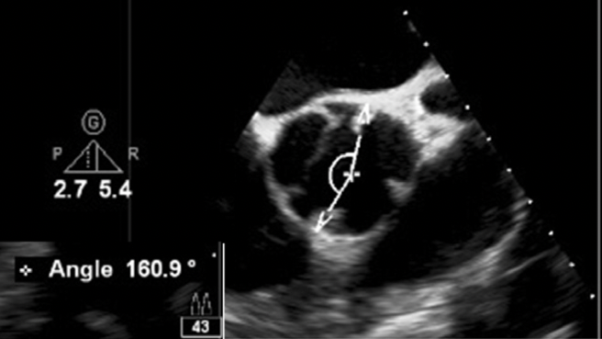

Slide 38
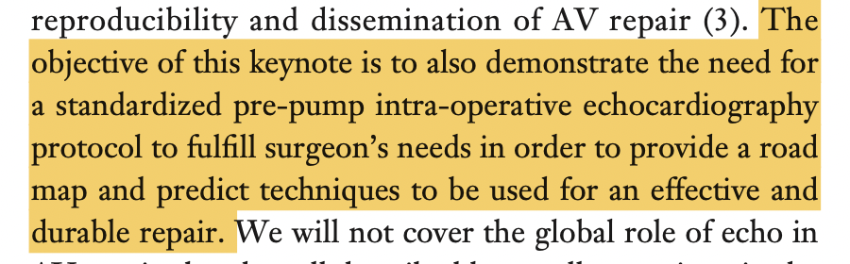
Berrebi A, Monin JL, Lansac E. Systematic echocardiographic assessment of aortic regurgitation— what should the surgeon know for aortic valve repair? Ann Cardiothorac Surg 2019;8(3):331-341. doi: 10.21037/ acs.2019.05.15

Slide 39
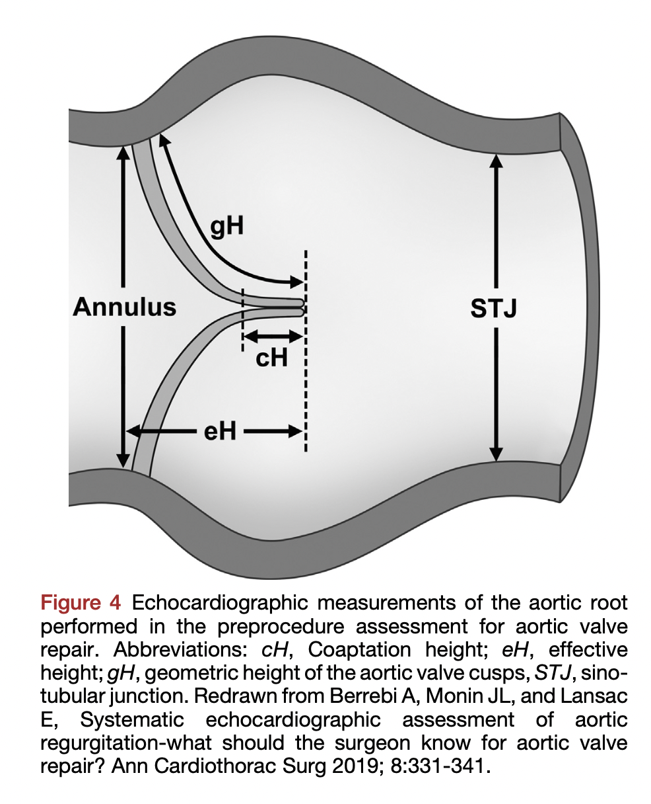

Slide 40
Effective height (eH): orthogonal distance from annulus to middle of cusp free margin normal is 9 mm.
Coaptation height (cH): distance of cusp apposition in diastole. Normal is 4–5 mm.

Slide 41
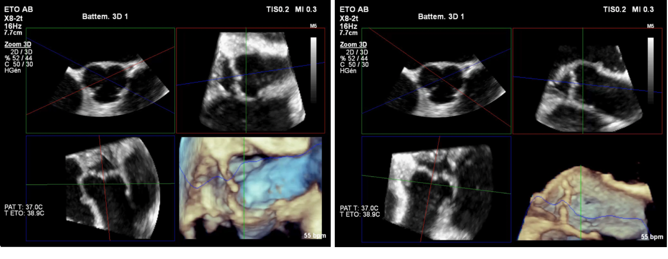
Effective height in 3D
The eH needs to be performed separately between each coaptation.

Slide 42
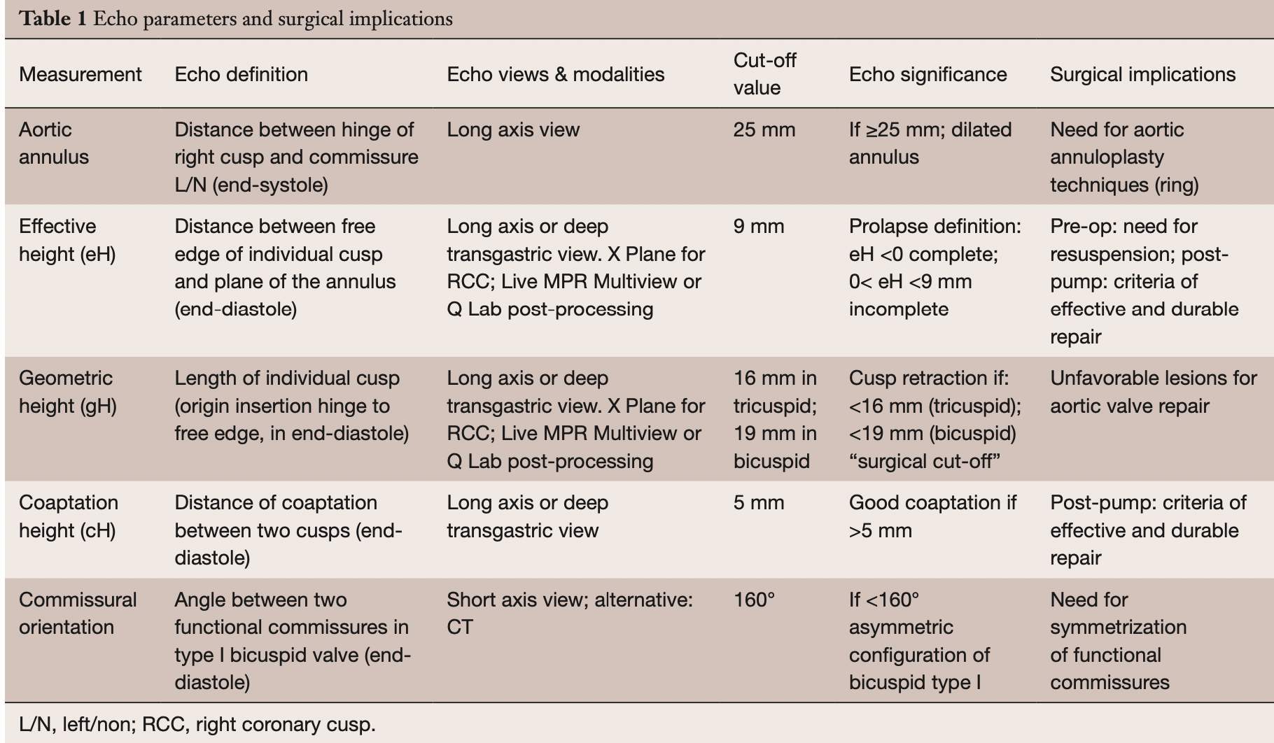
REPAIR FEASIBILITY
Valve symmetry

Slide 43
3. Review BAV repair

Slide 44
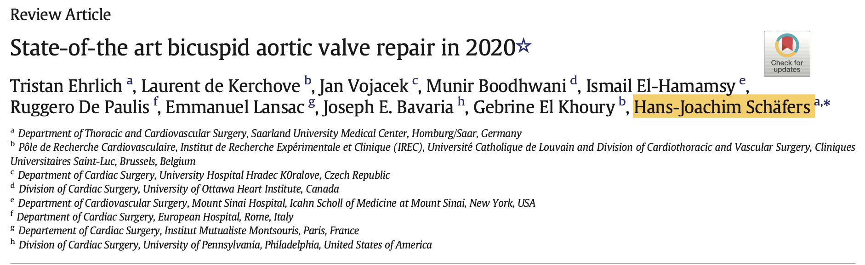


Slide 45
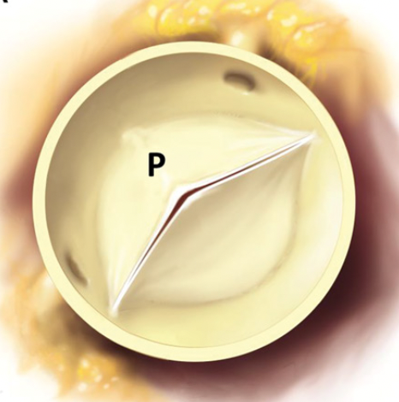
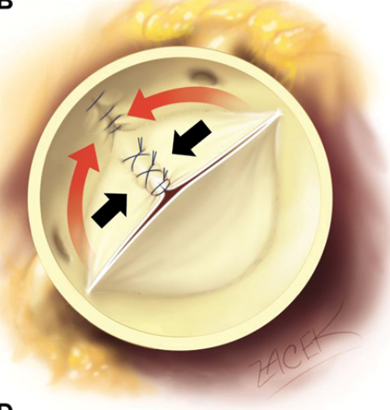
Central plication sutures to “Bicuspidize” the valve
Schneider, U., & Schäfers, H. J. (2017). Repair of the Bicuspid Aortic Valve. Operative Techniques in Thoracic and Cardiovascular Surgery, 22(2), 91–109. https://doi.org/10.1053/j.optechstcvs.2018.02.003

Slide 46
Sinus Plication
Schneider, U., & Schäfers, H. J. (2017). Repair of the Bicuspid Aortic Valve. Operative Techniques in Thoracic and Cardiovascular Surgery, 22(2), 91–109. https://doi.org/10.1053/j.optechstcvs.2018.02.003

Slide 47
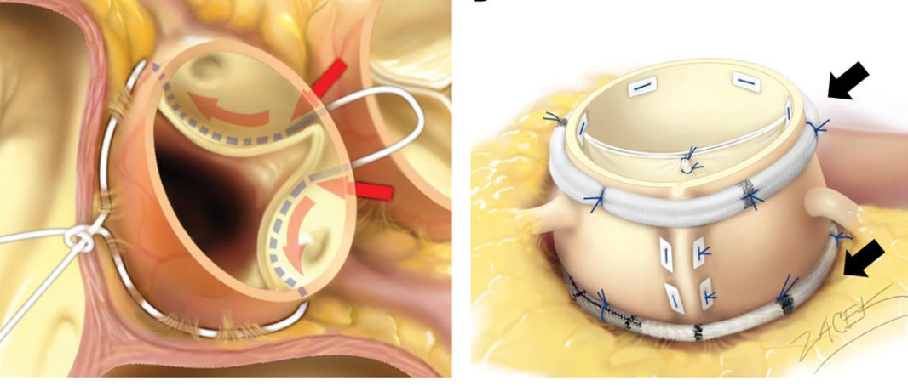
Suture Annuloplasty
Schneider, U., & Schäfers, H. J. (2017). Repair of the Bicuspid Aortic Valve. Operative Techniques in Thoracic and Cardiovascular Surgery, 22(2), 91–109. https://doi.org/10.1053/j.optechstcvs.2018.02.003

Slide 48
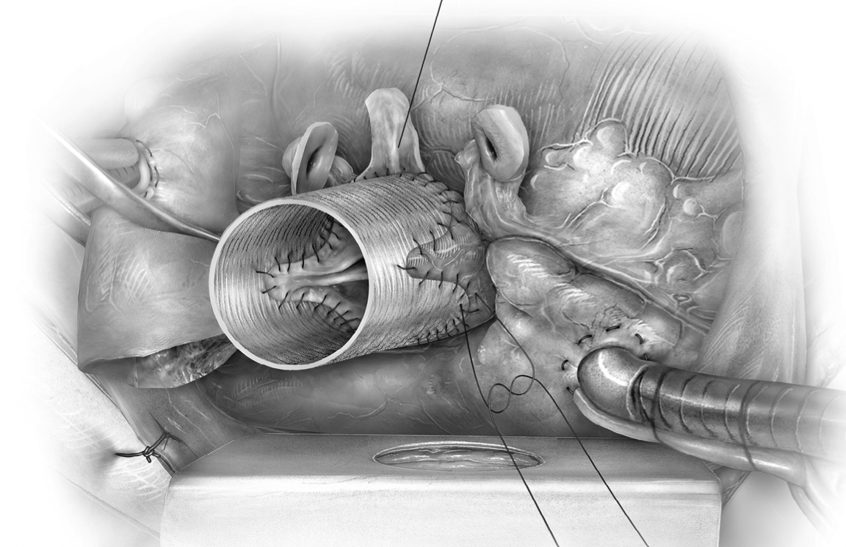
Root Remodeling
Notes:
Same valve repair as before but then change the root without the suture annuloplasty

Slide 49
ASE post AV repair
1)No/minimal residual AR.
2) Effective height >9mm
3)The coaptation height >4 mm
4)Aortic annulus diameter post repair should be <25 mm
5)The post-repair mean transvalvular pressure gradient < 10 mm Hg
Nicoara, A., Skubas, N., Ad, N., Finley, A., Hahn, R. T., Mahmood, F., Mankad, S., Nyman, C. B., Pagani, F., Porter, T. R., Rehfeldt, K., Stone, M., Taylor, B., Vegas, A., Zimmerman, K. G., Zoghbi, W. A., & Swaminathan, M. (2020). Guidelines for the Use of Transesophageal Echocardiography to Assist with Surgical Decision-Making in the Operating Room: A Surgery-Based Approach: From the American Society of Echocardiography in Collaboration with the Society of Cardiovascular Anesthesiologists and the Society of Thoracic Surgeons. Journal of the American Society of Echocardiography, 33(6), 692–734. https://doi.org/10.1016/j.echo.2020.03.002

Slide 50
Summary
1.BAV nomenclature: Fused, 2 Sinus, Partial fused ( Forme fruste)
2.BAV AR: TEE ECHO protocol
  Aortic annulus
  Effective height for each cusp
  GH
  cH
  Commissural angle
3.Repair Post TEE
  Minimal AR
  eH>9mm
  cH>4mm
  Aortic annulus <25mm
  Valvular gradient <10mmHg

Slide 51
References
1)Kong, W. K. F., Delgado, V., & Bax, J. J. (2017). Bicuspid aortic valve: What to image in patients considered for transcatheter aortic valve replacement? Circulation: Cardiovascular Imaging, 10(9). https://doi.org/10.1161/CIRCIMAGING.117.005987
2) Sievers HH, Schmidtke C. A classification system for the bicuspid aortic valve from 304 surgical specimens. J Thorac Cardiovasc Surg. 2007;133:1226–1233. doi: 10.1016/j.jtcvs.2007.01.039.
3) Sievers, H. H. (2021). The bicuspid aortic valve complex: Still a mystery. In European Journal of Cardio-thoracic Surgery (Vol. 60, Issue 3, pp. 479–480). European Association for Cardio-Thoracic Surgery. https://doi.org/10.1093/ejcts/ezab073
4) Schneider, U., Hofmann, C., Schöpe, J., Niewald, A. K., Giebels, C., Karliova, I., & Schäfers, H. J. (2020). Long-term Results of Differentiated Anatomic Reconstruction of Bicuspid Aortic Valves. JAMA Cardiology, 5(12), 1366–1373. https://doi.org/10.1001/jamacardio.2020.3749
5) Berrebi A, Monin JL, Lansac E. Systematic echocardiographic assessment of aortic regurgitation— what should the surgeon know for aortic valve repair? Ann Cardiothorac Surg 2019;8(3):331-341. doi: 10.21037/ acs.2019.05.15
6) Schneider, U., & Schäfers, H. J. (2017). Repair of the Bicuspid Aortic Valve. Operative Techniques in Thoracic and Cardiovascular Surgery, 22(2), 91–109. https://doi.org/10.1053/j.optechstcvs.2018.02.003
7) Nicoara, A., Skubas, N., Ad, N., Finley, A., Hahn, R. T., Mahmood, F., Mankad, S., Nyman, C. B., Pagani, F., Porter, T. R., Rehfeldt, K., Stone, M., Taylor, B., Vegas, A., Zimmerman, K. G., Zoghbi, W. A., & Swaminathan, M. (2020). Guidelines for the Use of Transesophageal Echocardiography to Assist with Surgical Decision-Making in the Operating Room: A Surgery-Based Approach: From the American Society of Echocardiography in Collaboration with the Society of Cardiovascular Anesthesiologists and the Society of Thoracic Surgeons. Journal of the American Society of Echocardiography, 33(6), 692–734. https://doi.org/10.1016/j.echo.2020.03.002

