Slide 1
Echocargiographic assessment for PE
Sean McLean
VGH Perioperative echo rounds
June 4 2019

Slide 2
RHT = Right heart thrombus
Septal = abnormal septal motion
Fields et al. JASE 2017
Notes:
Meta-analysis of articles investigating echocardiographic signs to diagnose acute PE in ED (mostly) or ICU/ward
22 articles where raw data available
RH strain = mixed term
US operators varied in studies but most were unclear
Low sensitivity of all tests. Ie. echo useful as a rule in test

Slide 3
60/60 sign
30mmHg > (TR jet) < 60mmHg
Pulmonary accel time (PAT) < 60sec
  PAT <80-100sec = elevated PVR
  MPAP = 90 – (0.62 x PAT)
Sensitivity 25%
Specificity 94%
Notes:
Difficult to measure?

Slide 4
277 patients
  100 massive or submassive PE(44%); 87 subsegmental PE (36%); 90 no PE (39%)
  60/60 sign, McConnell sign, Early systolic notching (ESN), other RVOT doppler parameters
Afonso et al JASE 2019

Slide 5
Early systolic notching (ESN)
PWD in RVOT
  Must be underneath PV
look for ”spike and dome” morphology
Notch time (NT) must occur in first half of ejection time (ET)

Slide 6
Early systolic notching
Normally, the pulmonary vascular bed has low impedance and produces small reflected pressure and flow waves that return to the RVOT after pulmonic valve closure. In this instance, wave reflection does not affect systolic pressure and flow characteristics. Practically, this typically produces a RVOT flow envelope without notching.
In the presence of increased PVR and low arterial compliance, reflected waves have greater magnitude and propagate more rapidly, arriving at the RVOT during systole. This results in systolic flow deceleration and RVOT flow envelope notching.
Arkles et al. Am J Respir Crit Care Med 2011
Notes:
Notching not observed in patients with elevated PA pressure from postcapillary (ie. left heart) hypertension
That is because PVR is not elevated.

Slide 7
Notes:
ESN observed in 92% of patients with massive or submassive PE.
ESN observed in 2% of patients with subsegmental, no patients without PE.

Slide 9
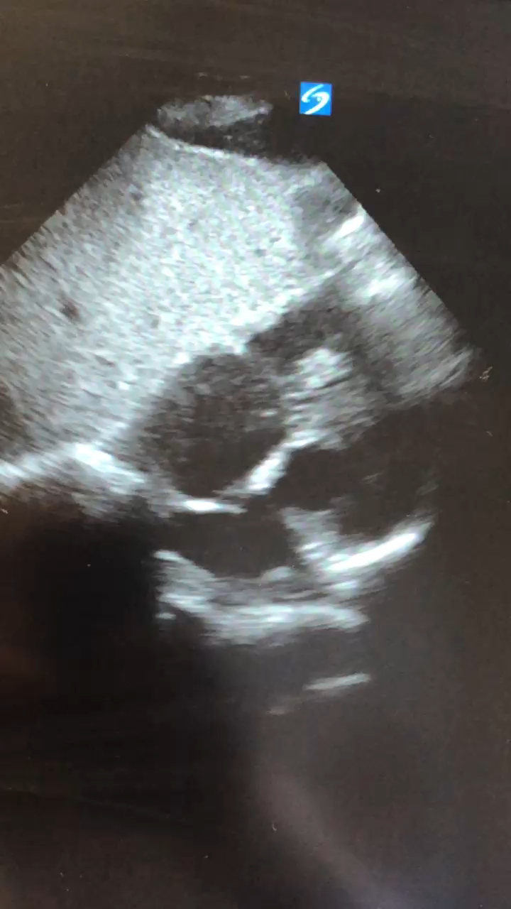

Slide 10
