Slide 1
QA for TEE
21 Feb 2023

Slide 2
Outline
Review of QA process
Findings from this QA round
Review Syngo Perioperative TEE reporting Template

Slide 3
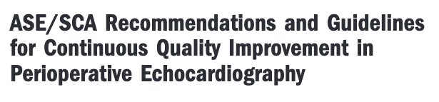
CQI in perioperative echocardiography is a continual process characterized by three assumptions about quality:
  a) technological advancements in echocardiography may redefine quality and therefore the ensuing recommendations,
  b) assessments of quality often require comparisons, and
  c) quality is enhanced by repetitive practice
Mathew et al. A and A I 2006
Notes:
QI in perioperative echocardiography has been discussed for many years. This ASE/SCA Recommendations and Guidelines paper from 2006 gives a good definition of what QI actually entails.
A - QI needs to be continuous to account for technological changes, new research findings and or new consensus guidelines. Advances in these field affects what we can image/measure/report
B - In order to quantify quality, comparisons with either accepted standards or a consensus across comparators is required. To determine the quality of a perioperative TEE study for example, comparisons to between multiple assessors can be used to assess the quality of a study.
C - Speaks to our acknowledgement that perioperative TEE is a ”use it or lose it skill” and we should be doing TEE with relative frequency to ensure that we maintain skill in image acquisition and interpretation

Slide 4
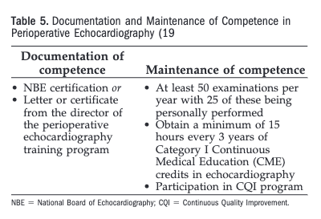
Mathew et al. A and A I 2006
Notes:
In the world of perioperative TEE we are fortunate that there are established criteria for competence. We must all maintain NBE certification as an initial documentation of competence.
As for the maintenance of competence, the SCA and ASE established this set of criteria back in 2006. They recommend…

Slide 5
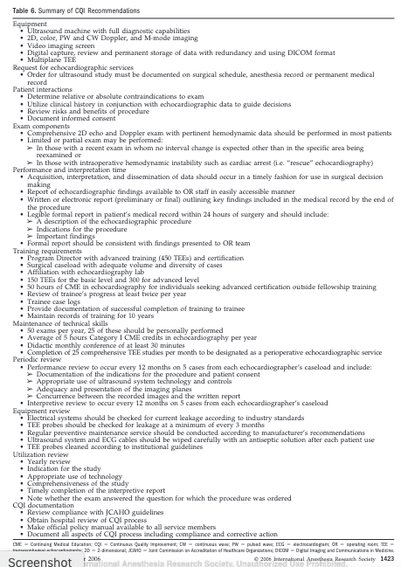
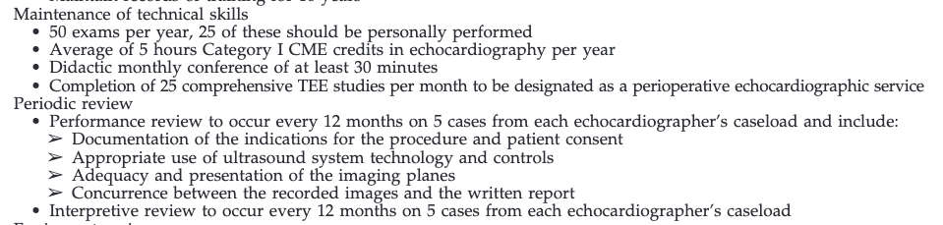
Mathew et al. A and A I 2006
Notes:
What does participation in a CQI program entail?

Slide 6
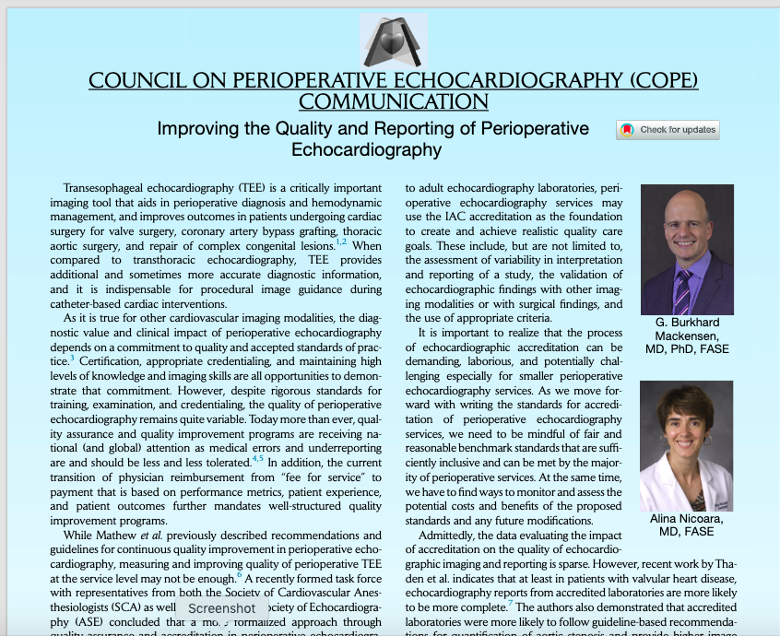

Notes:
In the US, the Intersocietal Accreditation Commission (IAC) has been accrediting cardiology echo labs in the US for years. They provide standards documents for echo labs to use for internal QI programs to follow. They will independently audit echo studies from an echo lab on a three year basis to ensure that documentation, image capture and reporting meet their established standards.
This bulletin, released in 2018, highlight an initiative to develop a similar accreditation program for perioperative TEE services.

Slide 7
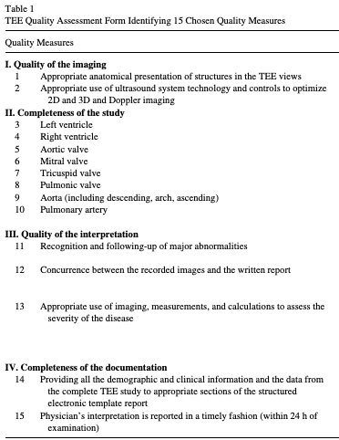
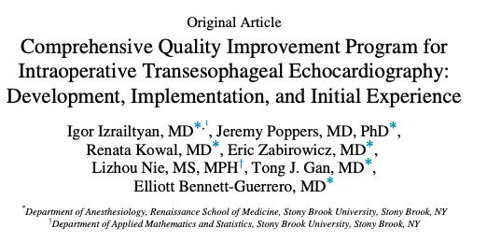
Notes:
There is data now to support that a continuous QI process can improve TEE image acquisition and reporting quality
This study from 2021 involved in house blinded re-interpretation of TEE studies to identify degree of quality of a perioperative TEE study based on the 15 different quality metrics you see here. After blinded scoring of each others studies within a cardiac anesthesia department, the data were summarized and fed back to each individual practitioner. Then the whole audit was repeated a few months later involving the same individuals and there was a statistically significant improvement in 5 of these quality metrics noted.

Slide 8
The QI process
Initially conceived in Jan 2020, prior to expansion of TEE group
SM and CD (+ BH, DM, CM)
independently review 5 random studies (from year prior) per individual.
  Meet to discuss each study
  Identify themes and areas for improvement
Report back to the group twice/year

Slide 9
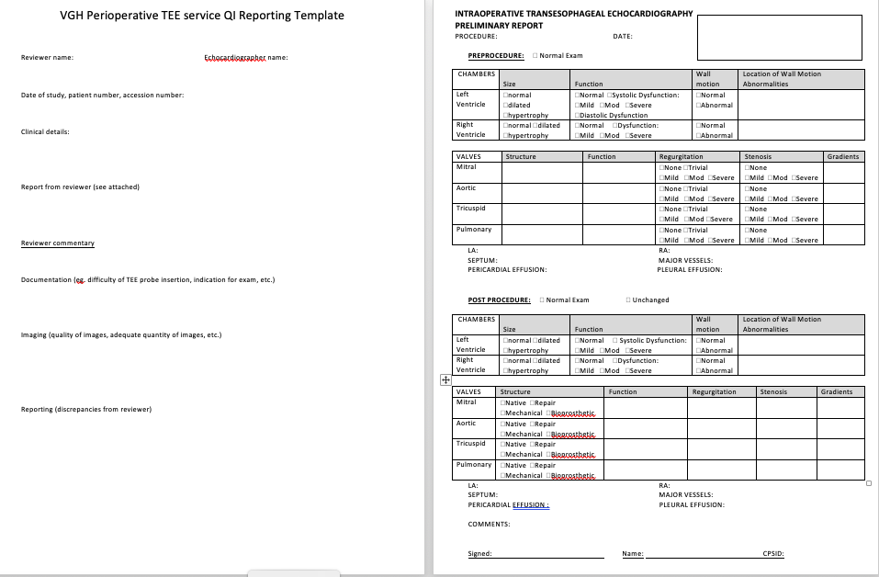
QI reporting template
Independently review images and report the study
Compare reports
Provide commentary on the quality of:
Documentation
Imaging
Interpretation
Notes:
Divided QI areas into commentary on the Documentation, Imaging, and Interpretation

Slide 10
Themes and issues identified by QI group

Slide 11
Documentation
Review work by trainees
  Images captured and documentation produced
Discuss and annotate study limitations
  Eg. HR, BP or pacing used when assessing valvular dysfunction or post-procedure gradients
Document in “post” tab:
  Procedure details
  Prosthesis details (type, size, regurg?, gradients?)

Slide 12
Imaging
Review and edit:
  Trainee work
  Junk images
Valve gradients
  Use CWD, and not PWD
Circulatory support cannulae
  ECMO
  Bicaval cannulation

Slide 13
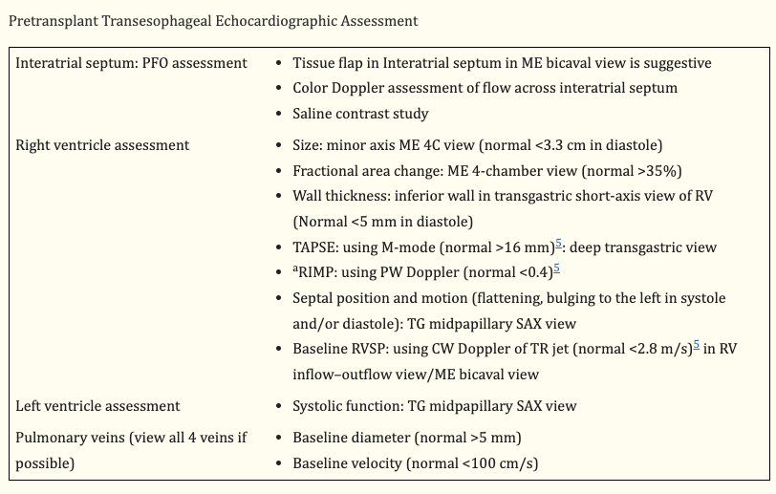
Lung transplant echo
RV function
Presence of PFO
RPA flow
PV flow
Evans Anesth Analg 2014

Slide 14
Interpretation
Valvular and ventricular dysfunction
  Mild or worse must be quantified
RV dimensions

Slide 15
RV measurements
  If function is abnormal, must quantify
    TAPSE, s’, (TOMTEC 4D RV function?)
  RV linear dimensions best assessed in RV focused 4 chamber view
    Maximize end diastolic dimension while maintaining 4 chamber view
  RVH
    Normal RV thickness 3-5mm
    Measured end diastole (subcostal 4c for TTE)
Notes:
For TTE, RV dimensions are best estimated from a RV-focused apical four-chamber view obtained with either lateral or medial transducer orientation (Lang et al 2015)

Slide 16
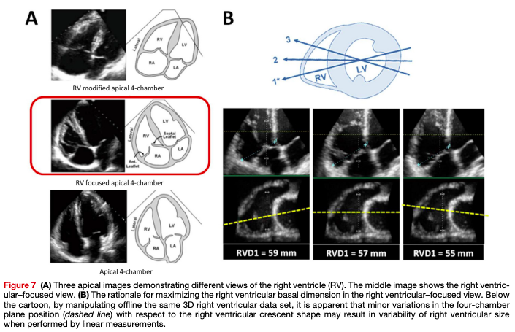
RV basal diameter (normal) = 25-41mm
RV mid diameter (normal) = 19-35mm

Slide 17
TEE communications
Email or text to next day TEE
  Improve reporting quality
  Include:
    Clinical variables and circumstances
    Special imaging performed
    Limitations
Documentation
  Record Epiq machine number and probe number on clipboard

Slide 18
Syngo TEE reporting template review

Slide 19
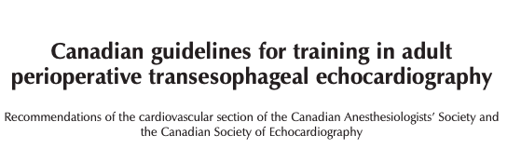
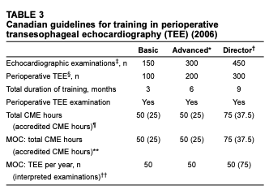
Beique et al. Can J Card 2006
Notes:
What about in Canada?
This document is from 2006 and no published update however other accreditation documents support the notion of 50 comprehensive TEE per year.
Total CME hours quoted here are over a four year period.
Note that our VGH Perioperative Echo Rounds are CME accredited. We do 10 rounds per year at 30 min per rounds = 5 hours of CME/year in perioperative echo.

